Slide 1
CSC 323 – Principles of Operating Systems
Instructor: Ms. Mamoona Tasadduq
Lecture# 09: Memory Management

Slide 2
Recap
To run a process, it must be brought (from disk) into the main memory
Main memory and registers are only storage CPU can access directly
Memory unit only sees a stream of:
  addresses + read requests, or
  address + data and write requests
Register access in one CPU clock (or less)
Main memory can take many cycles, causing a stall
Cache sits between main memory and CPU registers
Protection of memory required to ensure correct operation

Slide 3
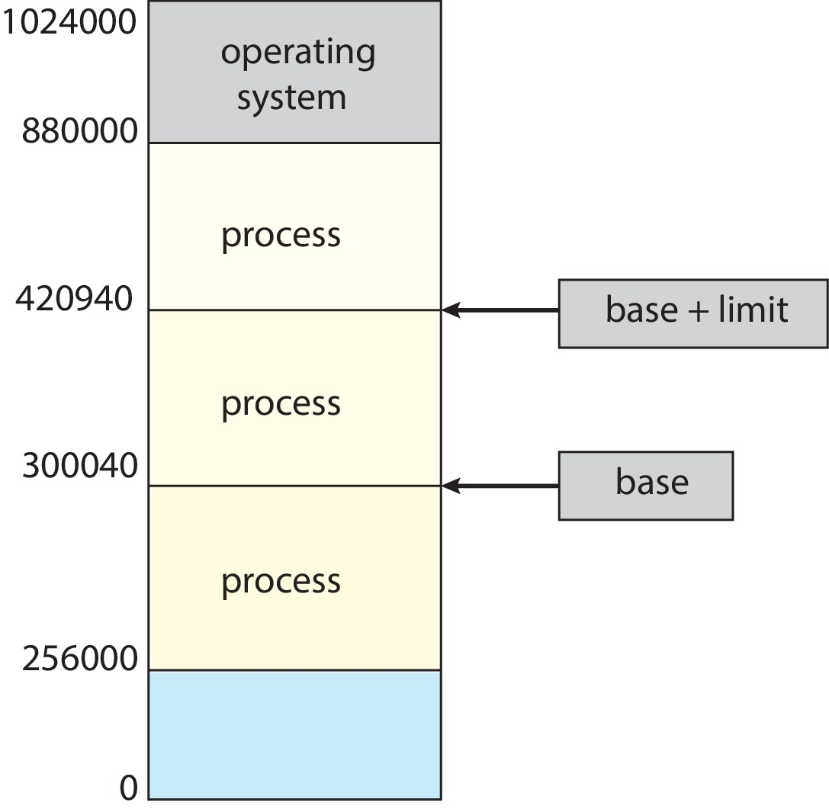
Memory Protection
Why?
  OS must protect programs from each other
  OS must protect itself from user programs
Need to ensure that a process can only access addresses in its address space.
Memory management hardware (MMU) provides the mechanisms
  Base and limit registers
  Page table pointers, page protection, segmentation, TLB
  Manipulating the hardware uses protected (privileged) operations

Slide 4
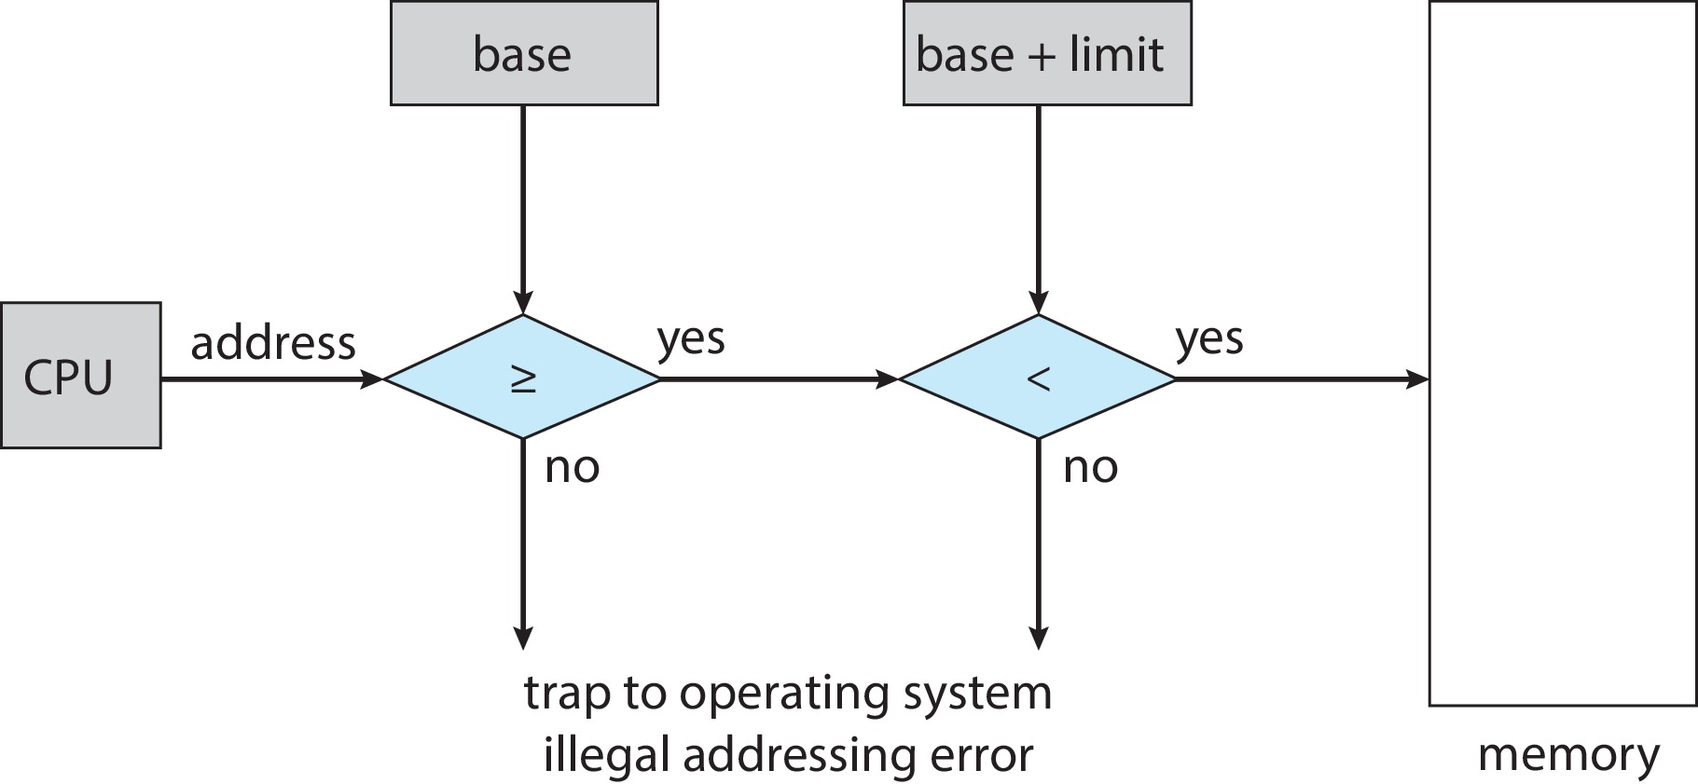
Hardware Address Protection
CPU must check every memory access generated in user mode to be sure it is between base and limit for that user
the instructions to loading the base and limit registers are privileged

Slide 5
Address Binding
Programs reside on disk, ready to be brought into memory to execute from an input queue
  Without support, must be loaded into address 0000
Inconvenient to have first user process physical address always at 0000
Addresses represented in different ways at different stages of a program’s life
  Source code addresses are usually symbolic
  Compiled code addresses bind to relocatable addresses
    i.e. “14 bytes from beginning of this module”
  Linker or loader will bind re-locatable addresses to absolute addresses
    i.e. 74014
  Each binding maps one address space to another

Slide 6
Binding of Instructions and Data to Memory
Address binding of instructions and data to memory addresses can happen at three different stages:
Compile Time – If memory location known a prior, then absolute code can be generated; must recompile code if starting location changes
Load Time – Must generate re-locatable code if memory location is not known at compile time.
Execution Time – Binding delayed until run time if the process can be moved during its execution from one memory segment to another
  Need hardware support for address maps (e.g., base & limit registers)

Slide 7
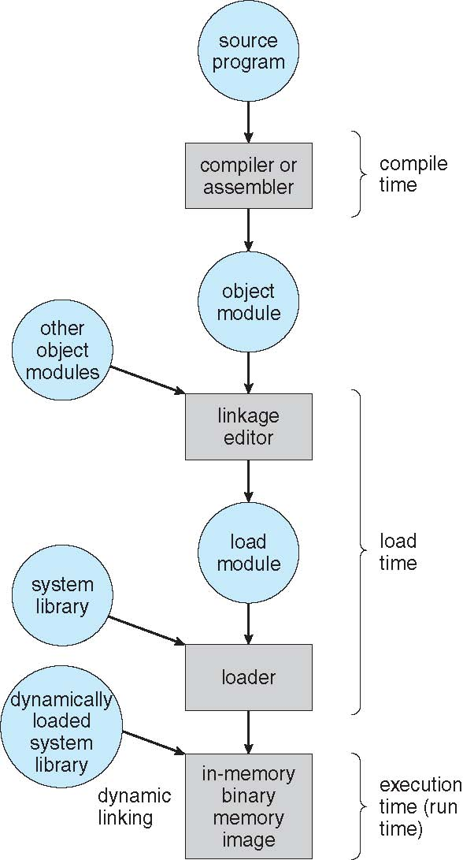
Multistep Processing of a User Program

Slide 8
Overlays
For execution, the executable code must be present in the main memory.
What if the size of code and data exceeds the size of main memory ?
Overlays
  Partition the program into mutually exclusive partitions
  Load the first partition
  After its execution, replace it with the next partition
    As the code and data of the first is no longer needed.

Slide 9
Logical vs. Physical Address Space
The concept of a logical address space that is bound to a separate physical address space is central to proper memory management
  Logical address – generated by the CPU; also referred to as virtual address
  Physical address – address seen by the memory unit
Logical and physical addresses are the same in compile-time and load-time address-binding schemes; logical (virtual) and physical addresses differ in execution-time address-binding scheme
Logical address space is the set of all logical addresses generated by a program
Physical address space is the set of all physical addresses generated by a program, corresponding to the set of logical addresses

Slide 10
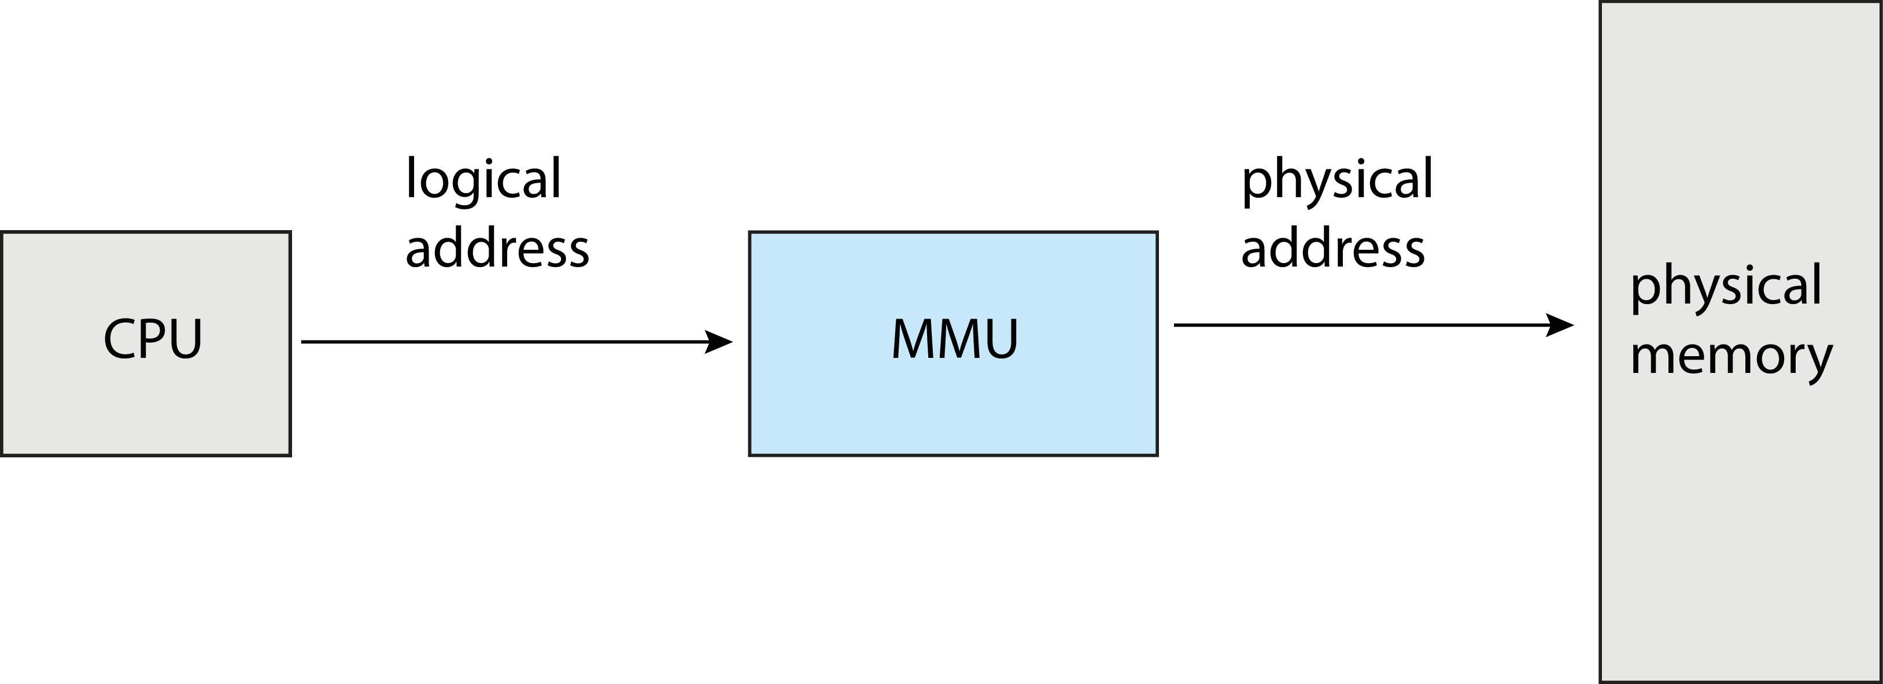
Memory-Management Unit (MMU)
Hardware device that maps virtual to physical address at run time
Many methods possible, covered in the rest of this chapter
Consider simple scheme where the value in the relocation register (base-register) is added to every address generated by a user process at the time it is sent to memory
The user program deals with logical addresses; it never sees the real physical addresses
  Execution-time binding occurs when reference is made to location in memory
  Logical address bound to physical addresses

Slide 11
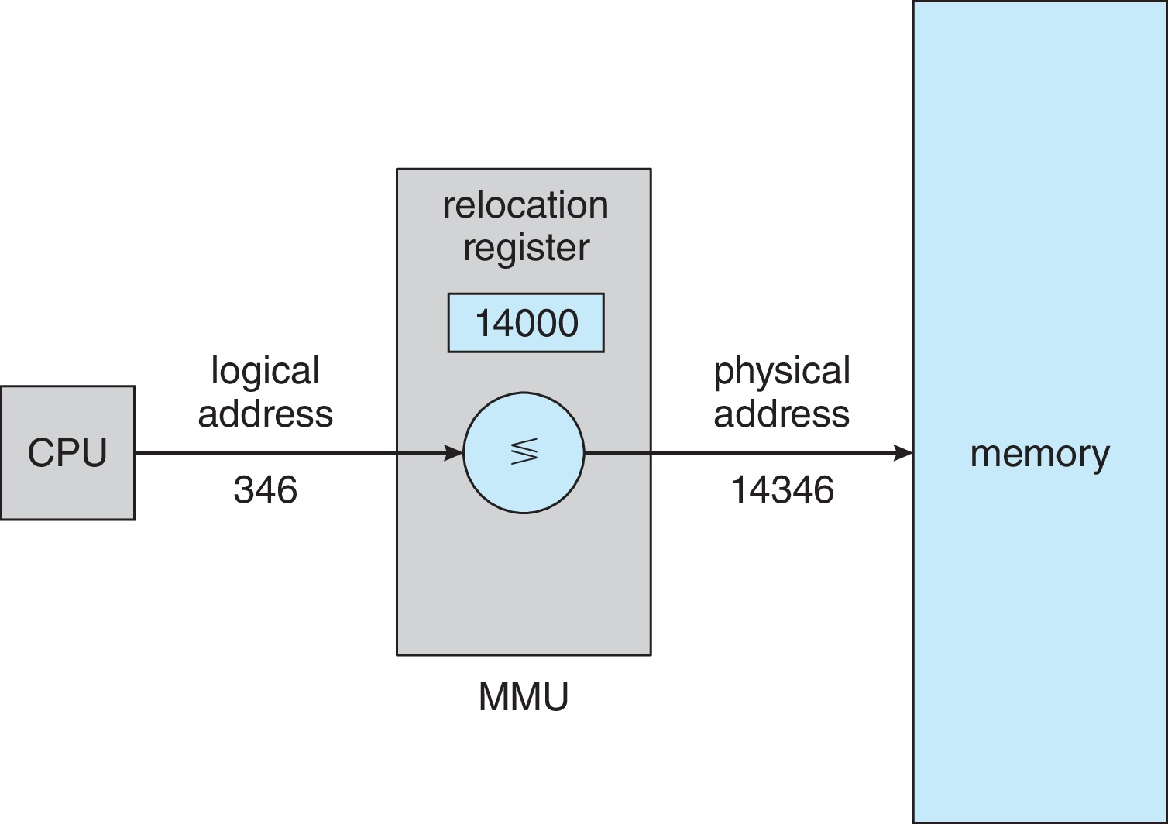
Memory-Management Unit (MMU)
If there are five users working on a system, each of the user processes have logical address space starting at zero.
However, each will be mapped to different physical address in the main memory.
User A having a logical address space from 0 – 150 can have its physical address space from 2000 – 2150
User B also having a logical address space from 0 – 150 can have its physical address space from 4000 – 4150

Slide 12
Dynamic Loading
The entire program does not need to be in memory to execute
Routine is not loaded until it is called
Better memory-space utilization; unused routine is never loaded
All routines kept on disk in relocatable load format
Useful when large amounts of code are needed to handle infrequently occurring cases
No special support from the operating system is required
  Implemented through program design
  OS can help by providing libraries to implement dynamic loading

Slide 13
Dynamic Linking
Static linking – system libraries and program code combined by the loader into the binary program image
Dynamic linking –linking postponed until execution time
  Without this facility, all programs on a system need to have a copy of their language library included in the executable image wasting both disk space and main memory
With dynamic linking, a small piece of code called stub is used to locate the appropriate memory-resident library routine
Stub replaces itself with the address of the routine, and executes the routine
Operating system checks if routine is in processes’ memory address
  If not in address space, add to address space
Dynamic linking is particularly useful for libraries
System also known as shared libraries
Consider applicability to patching system libraries
  Versioning may be needed

Slide 14
Contiguous Allocation
Main memory must support both OS and user processes
Limited resource, must allocate efficiently
Contiguous allocation is one of the early methods
Main memory is usually divided into two partitions:
  Resident operating system, usually held in low memory with interrupt vector
  User processes then held in high memory
  Each process contained in single contiguous section of memory
Relocation registers used to protect user processes from each other, and from changing operating-system code and data
  Base register contains value of smallest physical address
  Limit register contains range of logical addresses – each logical address must be less than the limit register
  MMU maps logical address dynamically

Slide 15
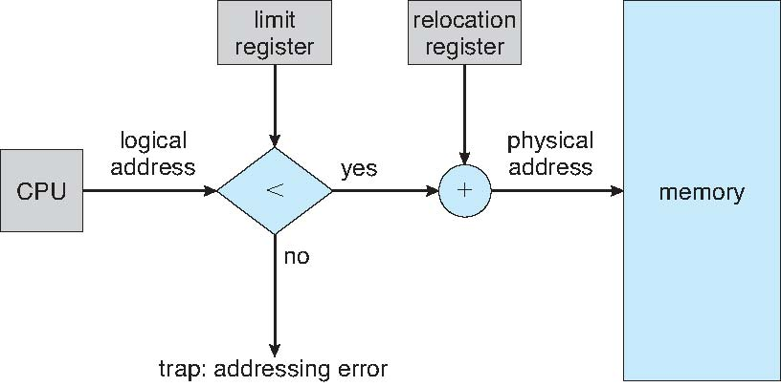
Contiguous Allocation
Hardware Support for Relocation and Limit Registers

Slide 16
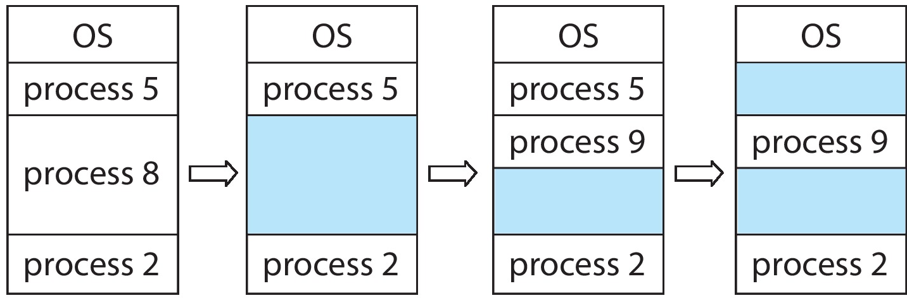
Variable Partition
Multiple-partition allocation
  Degree of multiprogramming limited by number of partitions
  Variable Partition sizes for efficiency (sized to a given process’ needs)
  Hole – block of available memory; holes of various size scattered throughout memory
  When a process arrives, it is allocated memory from a hole large enough to accommodate it
  Process exiting frees its partition, adjacent free partitions combined
  Operating system maintains information about
  a) allocated partitions
  b) free partitions (hole)

Slide 17
Dynamic Storage-Allocation Problem
How to satisfy a request of size n from a list of free holes?
  First-fit: Allocate the first hole that is big enough
  Best-fit: Allocate the smallest hole that is big enough; must search entire list, unless ordered by size (produces the smallest leftover hole)
  Next-fit: Allocate the next hole that is big enough from the last allocated block
  Worst-fit: Allocate the largest hole; must also search entire list (produces the largest leftover hole)

Slide 18

Dynamic Storage-Allocation Problem
Example: Given memory holes (i.e., unused memory blocks) of 100K, 500K, 200K, 300K and 600K (in address order) as shown below, how would each of the first-fit, next-fit, best-fit and worst-fit algorithms allocate memory requests for 290K, 420K, 110K and 350K (in this order)? The shaded areas are used/allocated regions and are not available.

Slide 19
Fragmentation
External Fragmentation – total memory space exists to satisfy a request, but it is not contiguous.
Internal Fragmentation – Allocated memory may be slightly larger than requested memory; this size difference is memory internal to a partition but not being used.
First fit analysis shows that given N blocks allocated, 0.5 N blocks lost to fragmentation
Reduce external fragmentation by compaction
  Shuffle memory contents to place all free memory together in one large block
  Compaction is possible only if relocation is dynamic, and is done at execution time
Now consider that backing store has same fragmentation problems

Slide 20
Compaction
First Possibility
Second Possibility
Third Possibility
0 KB
0 KB
0 KB
0 KB
OS
P1
P2
400 KB Free
P3 (200 KB)
300 KB Free
P4 (400 KB)
200 KB Free
OS
P1
P2
P3
P4
900 KB Free
OS
P1
P2
P4
P3
900 KB Free
OS
P1
P2
900 KB Free
P4
P3
400 KB
400 KB
400 KB
400 KB
600 KB
600 KB
600 KB
600 KB
700 KB
700 KB
700 KB
700 KB
1100 KB
900 KB
1100 KB
1300 KB
1300 KB
1300 KB
1600 KB
1600 KB
2000 KB
2000 KB
2200 KB
2200 KB
2200 KB
2200 KB
2 moves required and 600 KB data moved (P3 & P4 moved up)
1 move required and 400 KB data moved (P4 moved up)
1 move required and 200 KB data moved (P3 moved down)

Slide 21
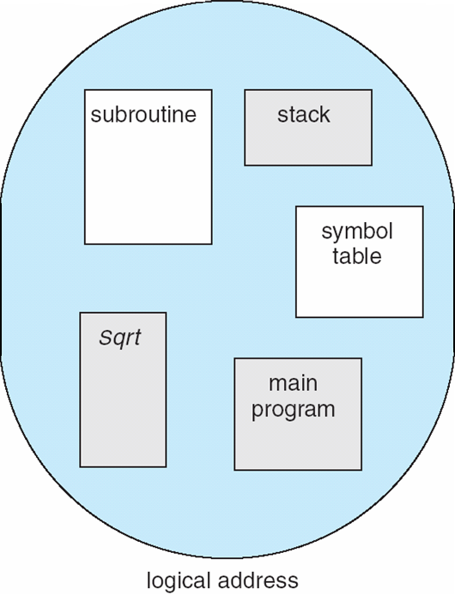
Segmentation
Memory-management scheme that supports user view of memory
A program is a collection of segments
  A segment is a logical unit such as main program, procedure, function, method, object, local variables, global variables, common block, stack, symbol table, arrays, etc.
1
1
4
2
3
4
2
3
User’s View of a Program
user space
physical memory space

Slide 22
Segmentation Architecture
Logical address consists of a two tuple:
<segment-number, offset>,
Segment table – maps two-dimensional physical addresses; each table entry has:
  base – contains the starting physical address where the segments reside in memory
  limit – specifies the length of the segment
Segment-table base register (STBR) points to the segment table’s location in memory
Segment-table length register (STLR) indicates number of segments used by a program;
segment number s is legal if s < STLR

Slide 23
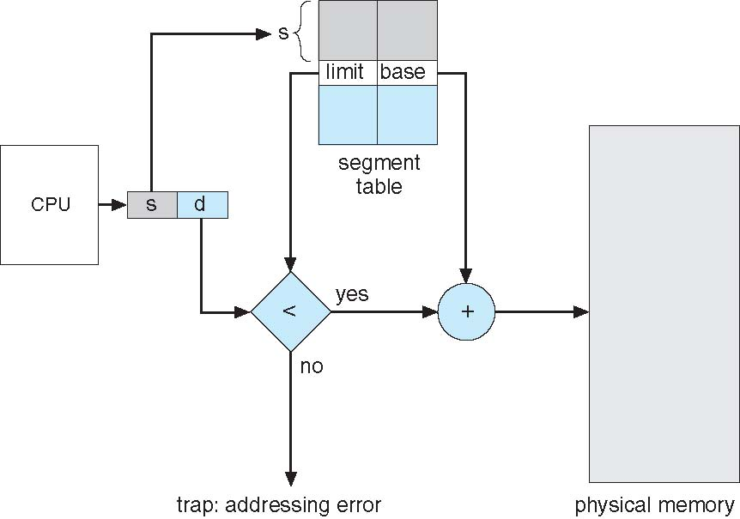
Segmentation Hardware

Slide 24
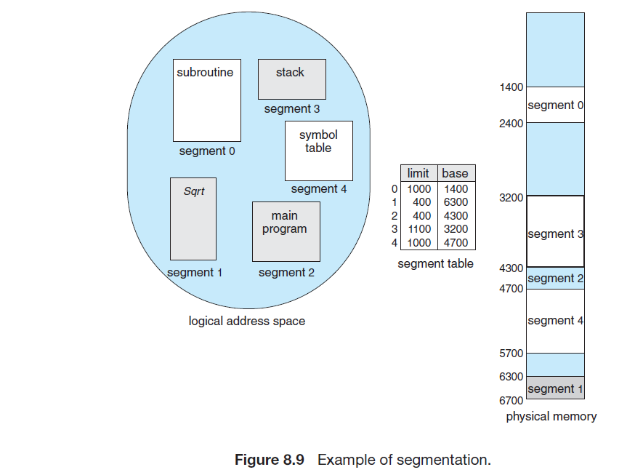
Segmentation Example

Slide 25
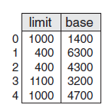
Segmentation Example
Consider the following segment table:
What are the physical addresses for the following logical addresses?
  0, 1222
  2, 53
  3, 852

Slide 26
Paging
Physical address space of a process can be noncontiguous; process is allocated physical memory whenever the latter is available
  Avoids external fragmentation
  Avoids problem of varying sized memory chunks
Divide physical memory into fixed-sized blocks called frames
  Size is power of 2, between 512 bytes and 16 Mbytes
Divide logical memory into blocks of same size called pages
Keep track of all free frames
To run a program of size N pages, need to find N free frames and load program
Set up a page table to translate logical to physical addresses
Backing store likewise split into pages
Still have internal fragmentation

Slide 27
Address Translation Scheme
Address generated by CPU is divided into:
  Page number (p) – used as an index into a page table which contains base address of each page in physical memory
  Page offset (d) – combined with base address to define the physical memory address that is sent to the memory unit
For given logical address space 2^{m} and page size 2^{n}
page number
page offset
p
d
m – n
n

Slide 28
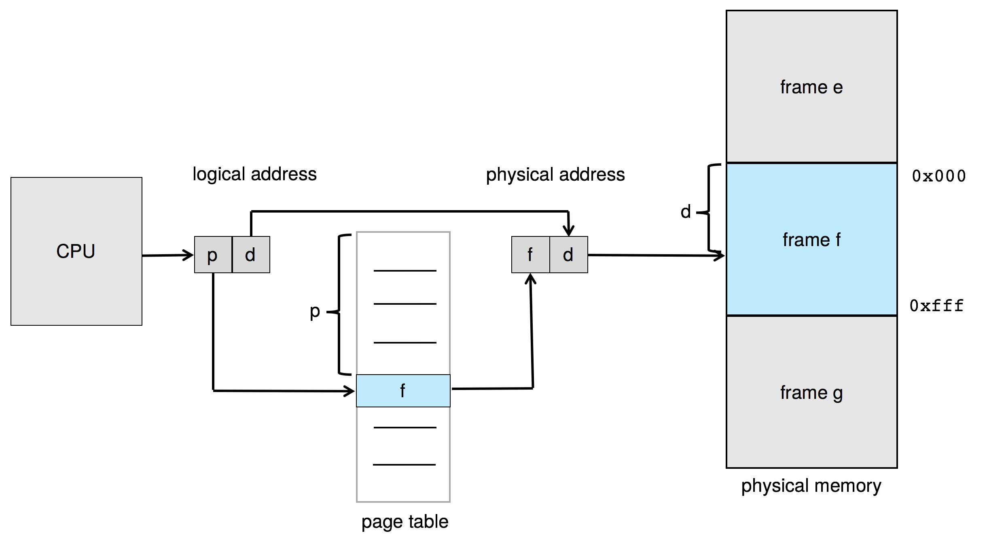
Paging Hardware

Slide 29

Paging Model of Logical & Physical Memory

Slide 30
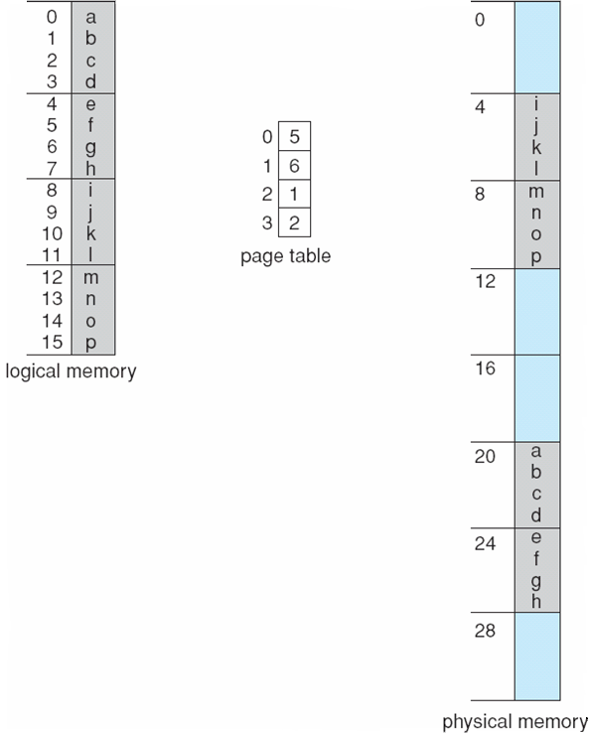
Paging Example
Logical address: n = 2 and m = 4. Using a page size of 4 bytes and a physical memory of 32 bytes (8 pages)
Logical address 0
  Page 0, offset 0
  Page 0 = frame 5 (5 x 4)
  20 + 0 =20
Logical address 3
  Page 0, offset 3
  Page 0 = frame 5 (5 x 4)
  20 + 3=23
Logical address 4
  Page 1, offset 0
  Page 1 = frame 6 (6 x 4)
  24 + 0=24

Slide 31
Paging – Calculating Internal Fragmentation
Page size = 2,048 bytes
Process size = 72,766 bytes
35 pages + 1,086 bytes
Internal fragmentation of 2,048 - 1,086 = 962 bytes
Worst case fragmentation = 1 frame – 1 byte
On average fragmentation = 1 / 2 frame size
So small page sizes desirable?
But each page table entry takes memory to track

Slide 32
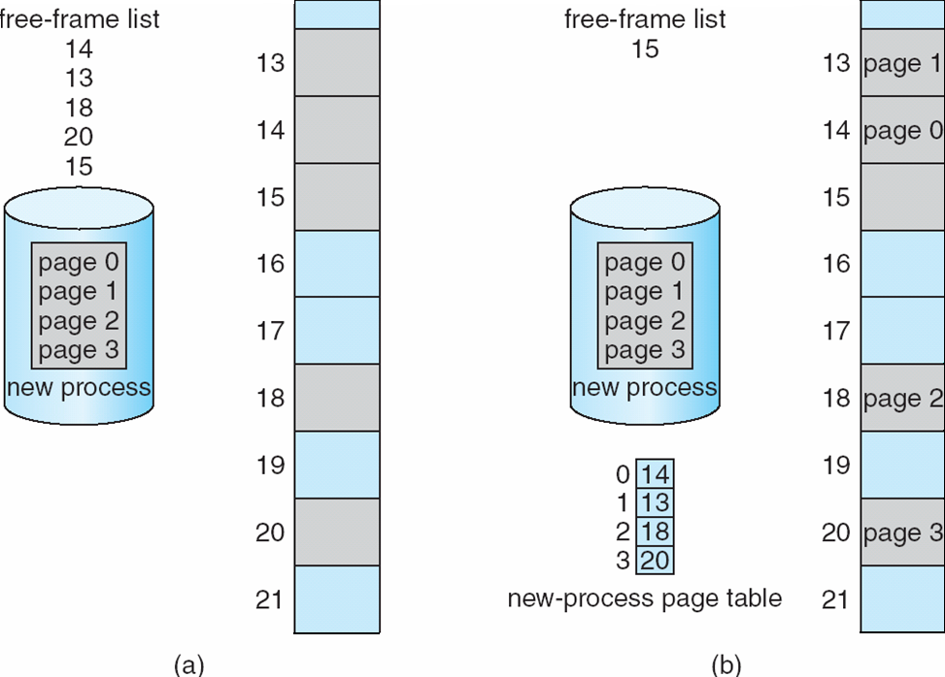
Free Frames
Before allocation
After allocation

Slide 33
Page Table Implementation
Page table is kept in main memory
Page-table base register (PTBR) points to the page table
Page-table length register (PTLR) indicates size of the page table
In this scheme every data/instruction access requires two memory accesses
  One for the page table and one for the data / instruction
The two-memory access problem can be solved using a special fast-lookup hardware cache called translation look-aside buffers (TLBs) (also called associative memory)
Some TLBs store address-space identifiers (ASIDs) in each TLB entry – uniquely identifies each process to provide address-space protection for that process
  Otherwise need to flush at every context switch

Slide 34
Translation Look-Aside Buffer
Some TLBs store address-space identifiers (ASIDs) in each TLB entry – uniquely identifies each process to provide address-space protection for that process
  Otherwise need to flush at every context switch
TLBs typically small (64 to 1,024 entries)
On a TLB miss, value is loaded into the TLB for faster access next time
  Replacement policies must be considered
  Some entries can be wired down for permanent fast access

Slide 35

Paging Hardware With TLB
Associative memory – parallel search
Address translation (p, d)
  If p is in associative register, get frame # out
  Otherwise get frame # from page table in memory

Slide 36
Effective Access Time
TLB Lookup = ε time unit
  Can be < 10% of memory access time
Hit ratio (α) – percentage of times that a page number is found in the TLB
Consider ε = 20 ns for TLB search, 100 ns for memory access
1 TLB hit = 20 + 100 ns, 1TLB miss = 120 +100 ns
Effective Access Time (EAT)
Consider α = 80%
  EAT= 0.80 x 120 + 0.20 x 220 = 140 ns
Consider more realistic hit ratio → α = 99%
  EAT = 0.99 x 120 + 0.01 x 220 = 121 ns

Slide 37
Memory Protection
Memory protection implemented by associating protection bit with each frame to indicate if read-only or read-write access is allowed
  Can also add more bits to indicate page execute-only, and so on
Valid-invalid bit attached to each entry in the page table:
  “valid” indicates that the associated page is in the process logical address space, and is thus a legal page
  “invalid” indicates that the page is not in the process logical address space
  Or use Page-table length register (PTLR)
Any violations result in a trap to the kernel

Slide 38
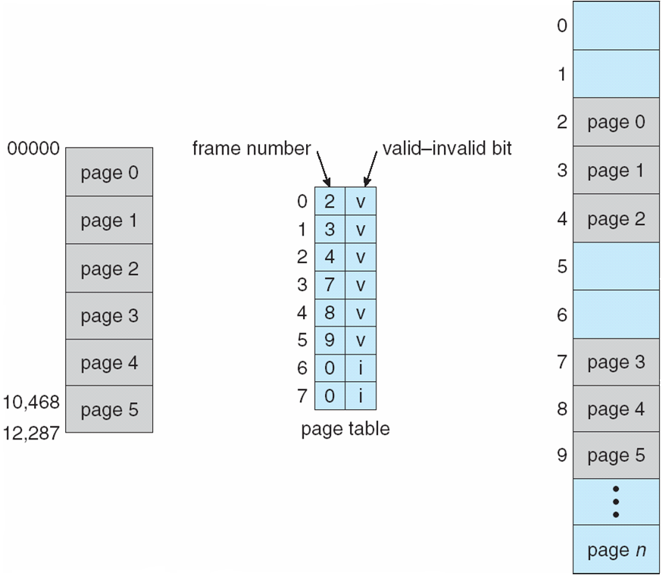
Memory Protection

Slide 39
Shared Pages
An advantage of paging is the possibility of sharing common code.
Shared code
  One copy of read-only (reentrant) code shared among processes (i.e., text editors, compilers, window systems)
  Similar to multiple threads sharing the same process space
  Also useful for interprocess communication if sharing of read-write pages is allowed
Private code and data
  Each process keeps a separate copy of the code and data
  The pages for private code and data can appear anywhere in the logical address space

Slide 40
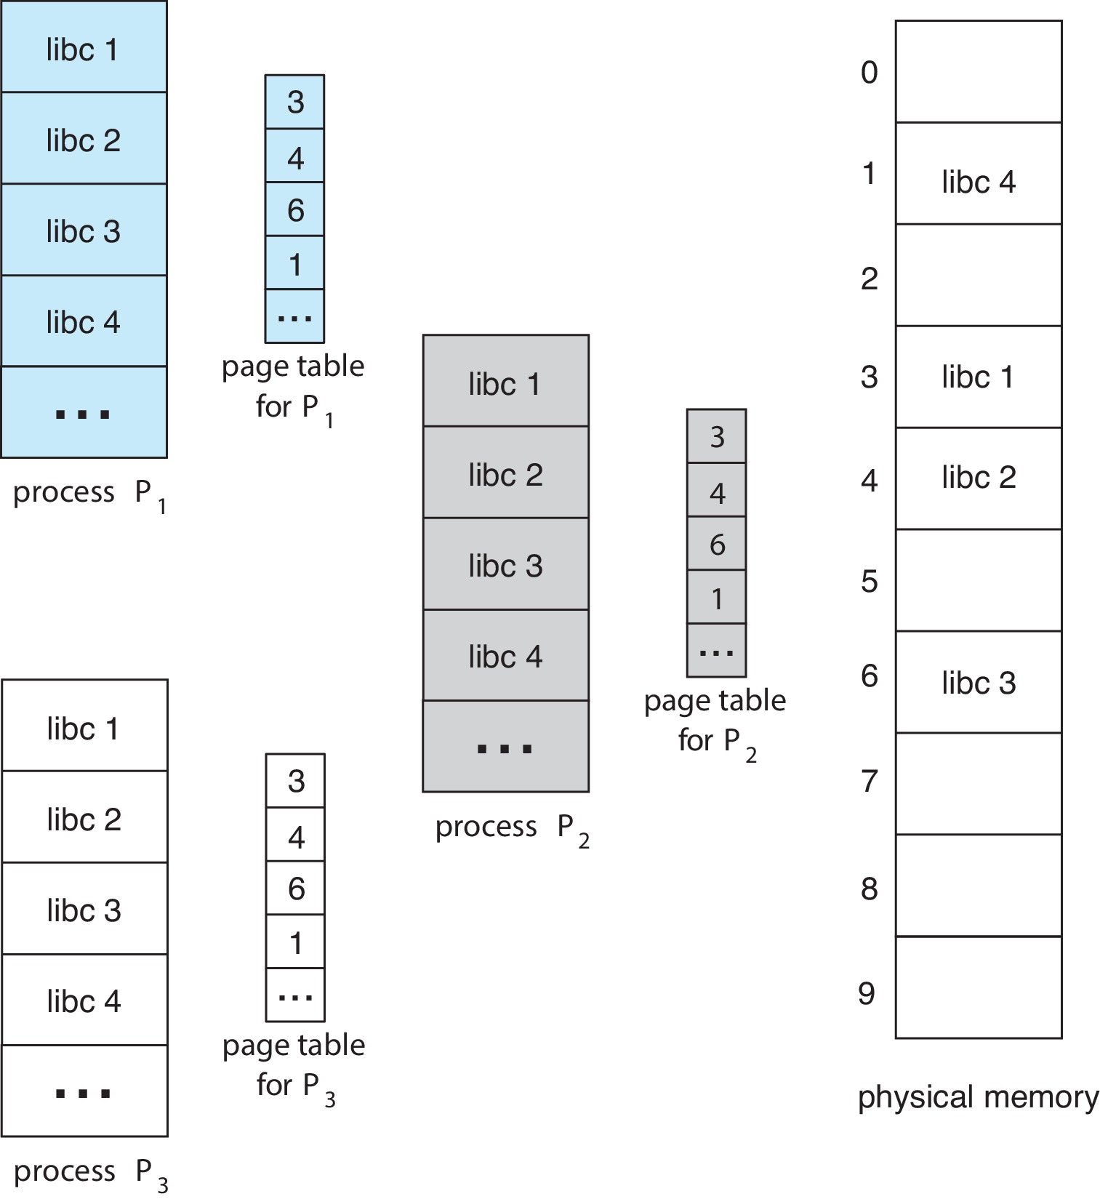
Shared Pages Example

Slide 41
Page Table Structure
Memory structures for paging can get huge using straight-forward methods
  Consider a 32-bit logical address space as on modern computers
  Page size of 4 KB (2¹²)
  Page table would have 1 million entries (2³² / 2¹²)
  If each entry is 4 bytes ➔ each process has 4 MB of physical address space for page table alone
    Don’t want to allocate that contiguously in main memory
One simple solution is to divide the page table into smaller units
  Hierarchical Page Tables
  Hashed Page Tables
  Inverted Page Tables

Slide 42
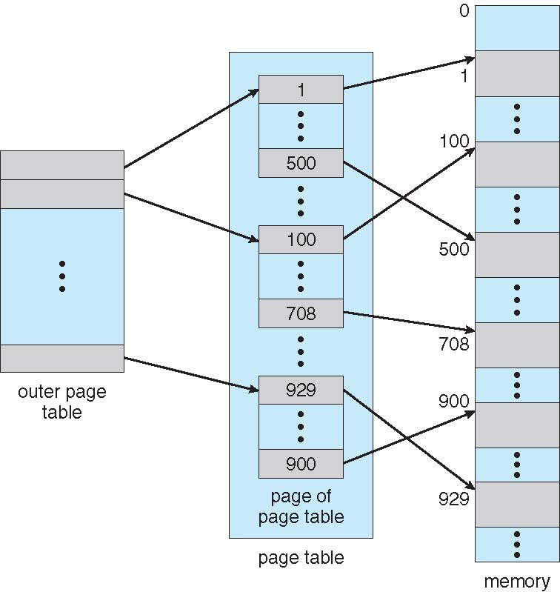
Hierarchical Page Tables
Break up the logical address space into multiple page tables
A simple technique is a two-level page table
We then page the page table
A two-level page-table scheme

Slide 43
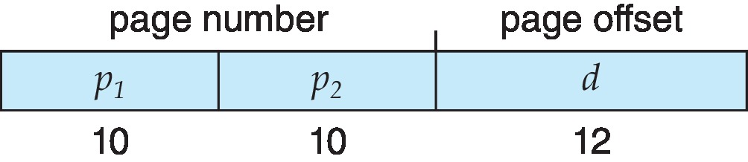
Hierarchical Page Tables: Two-Level Example
A logical address (on 32-bit machine with 4K page size) is divided into:
  A page number consisting of 20 bits
  A page offset consisting of 12 bits
Since the page table is paged, the page number is further divided into:
  A 10-bit page number
  A 10-bit page offset
Thus, a logical address is as follows:
where p₁ is an index into the outer page table, and p₂ is the displacement within the page of the inner page table
Known as forward-mapped page table
  Pentium-II uses this architecture

Slide 44
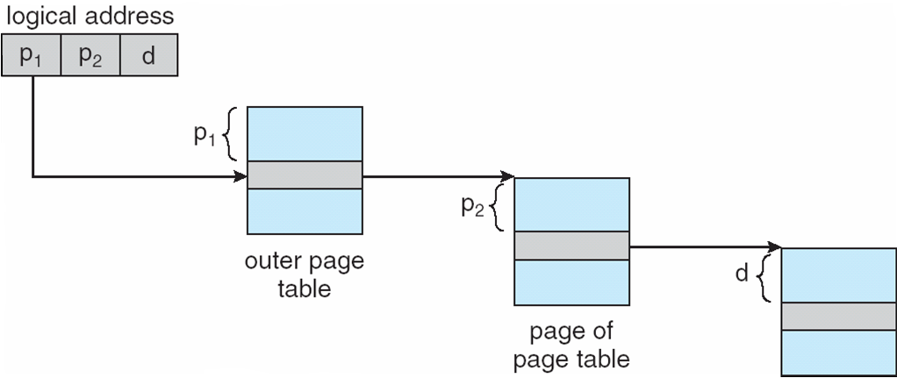
Hierarchical Page Tables: Address Translation

Slide 45
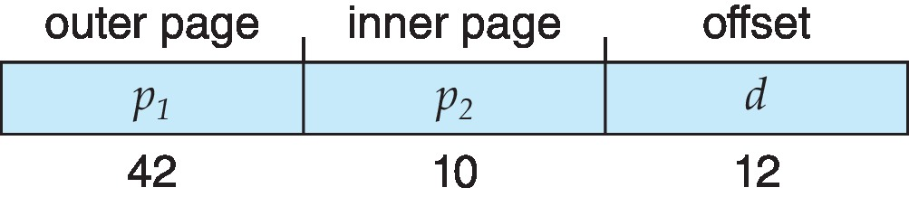
Hierarchical Page Tables
Consider 64-bit Logical Address Space. Even two-level paging scheme not sufficient
If page size is 4 KB (2¹²)
  Then page table has 2⁵² entries
  If two level scheme, inner page tables could be 2¹⁰ 4-byte entries
  Address would look like
  Outer page table has 2⁴² entries or 2⁴⁴ bytes
  One solution is to add a 2nd outer page table
  But in the following example the 2nd outer page table is still 2³² bytes in size
    And possibly 4 memory access to get to one physical memory location

Slide 46
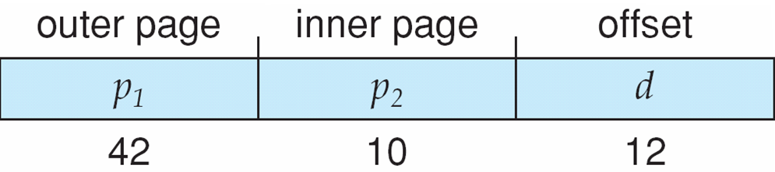
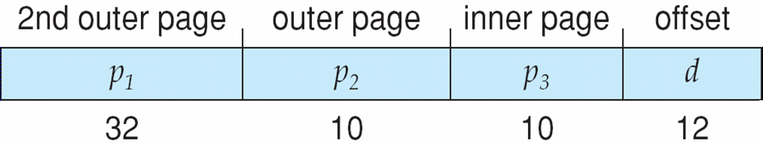
Hierarchical Page Tables
Three-Level Paging Scheme
For the same processing, 64-bit architecture may require 7 levels of paging

Slide 47
Hashed Page Tables
Common in address spaces > 32 bits
The virtual page number is hashed into a page table
  This page table contains a chain of elements hashing to the same location
Each element contains:
  The virtual page number
  The value of the mapped page frame
  A pointer to the next element
Virtual page numbers are compared in this chain searching for a match
  If a match is found, the corresponding physical frame is extracted
Variation for 64-bit addresses is clustered page tables
  Similar to hashed but each entry refers to several pages (such as 16) rather than 1
  Especially useful for sparse address spaces (where memory references are non-contiguous and scattered)

Slide 48
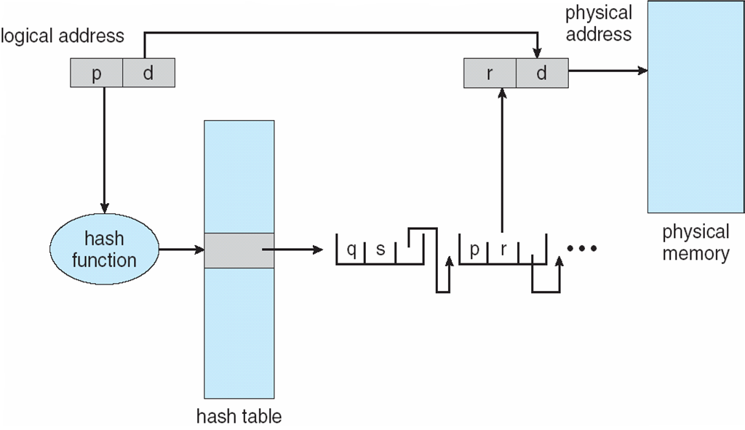
Hashed Page Tables

Slide 49
Inverted Page Table
Rather than each process having a page table and keeping track of all possible logical pages, track all physical pages
One entry for each real page of memory
Entry consists of the virtual address of the page stored in that real memory location, with information about the process that owns that page
Decreases memory needed to store each page table, but increases time needed to search the table when a page reference occurs
Use hash table to limit the search to one (or at most a few) page-table entries
  TLB can accelerate access
But how to implement shared memory?
  One mapping of a virtual address to the shared physical address

Slide 50
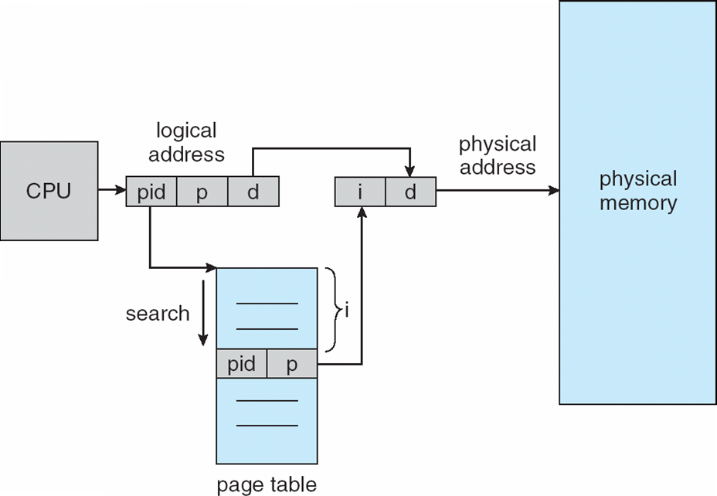
Inverted Page Table Architecture

Slide 51
Swapping
A process can be swapped temporarily out of memory to a backing store, and then brought back into memory for continued execution
Total physical memory space of processes can exceed physical memory
Backing store – Fast disk large enough to accommodate copies of all memory images for all users; must provide direct access to these memory images
Roll out, roll in – Swapping variant used for priority-based scheduling algorithms; lower-priority process is swapped out so higher-priority process can be loaded and executed
Major part of swap time is transfer time; total transfer time is directly proportional to the amount of memory swapped
System maintains a ready queue of ready-to-run processes which have memory images on disk

Slide 52
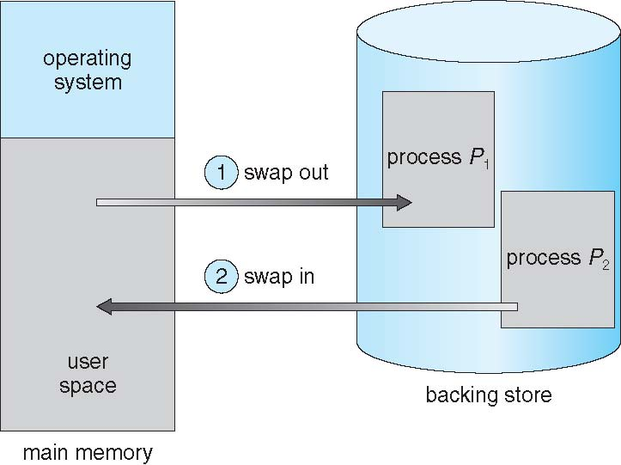
Swapping
Does the swapped-out process need to swap back into same physical addresses?
Depends on address binding method
  Plus consider pending I/O to/from process memory space
Modified versions of swapping are found on many systems (i.e., UNIX, Linux, and Windows)
  Swapping normally disabled
  Started if more than threshold amount of memory allocated
  Disabled again once memory demand reduced below threshold

Slide 53
Context Switch Time including Swapping
If next processes to be put on CPU is not in memory, need to swap out a process and swap in target process
Context switch time in such system can be very high
100MB process swapping to hard disk with transfer rate of 50MB/sec
  Swap out time of 2000 ms
  Assuming an average latency of 8 milliseconds, the swap time is 2008 milliseconds
  Total context switch swapping component time is 2016 milliseconds
Can reduce if reduce size of memory swapped – by knowing how much memory really being used
  System calls to inform OS of memory use via request_memory() and release_memory()

Slide 54
Context Switch Time including Swapping
Other constraints as well on swapping
  Pending I/O – can’t swap out as I/O would occur to wrong process
  Or always transfer I/O to kernel space, then to I/O device
    Known as double buffering, adds overhead
Standard swapping not used in modern operating systems
  But modified version common
    Swap only when free memory extremely low

Slide 55
Swapping on Mobile Systems
Not typically supported as it is flash memory based
  Small amount of space
  Limited number of write cycles
  Poor throughput between flash memory and CPU on mobile platform
Instead use other methods to free memory if low
iOS asks apps to voluntarily relinquish allocated memory
  Read-only data thrown out and reloaded from flash if needed
  Failure to free can result in termination
Android terminates apps if low free memory, but first writes application state to flash for fast restart
Both OSes support paging

Slide 56
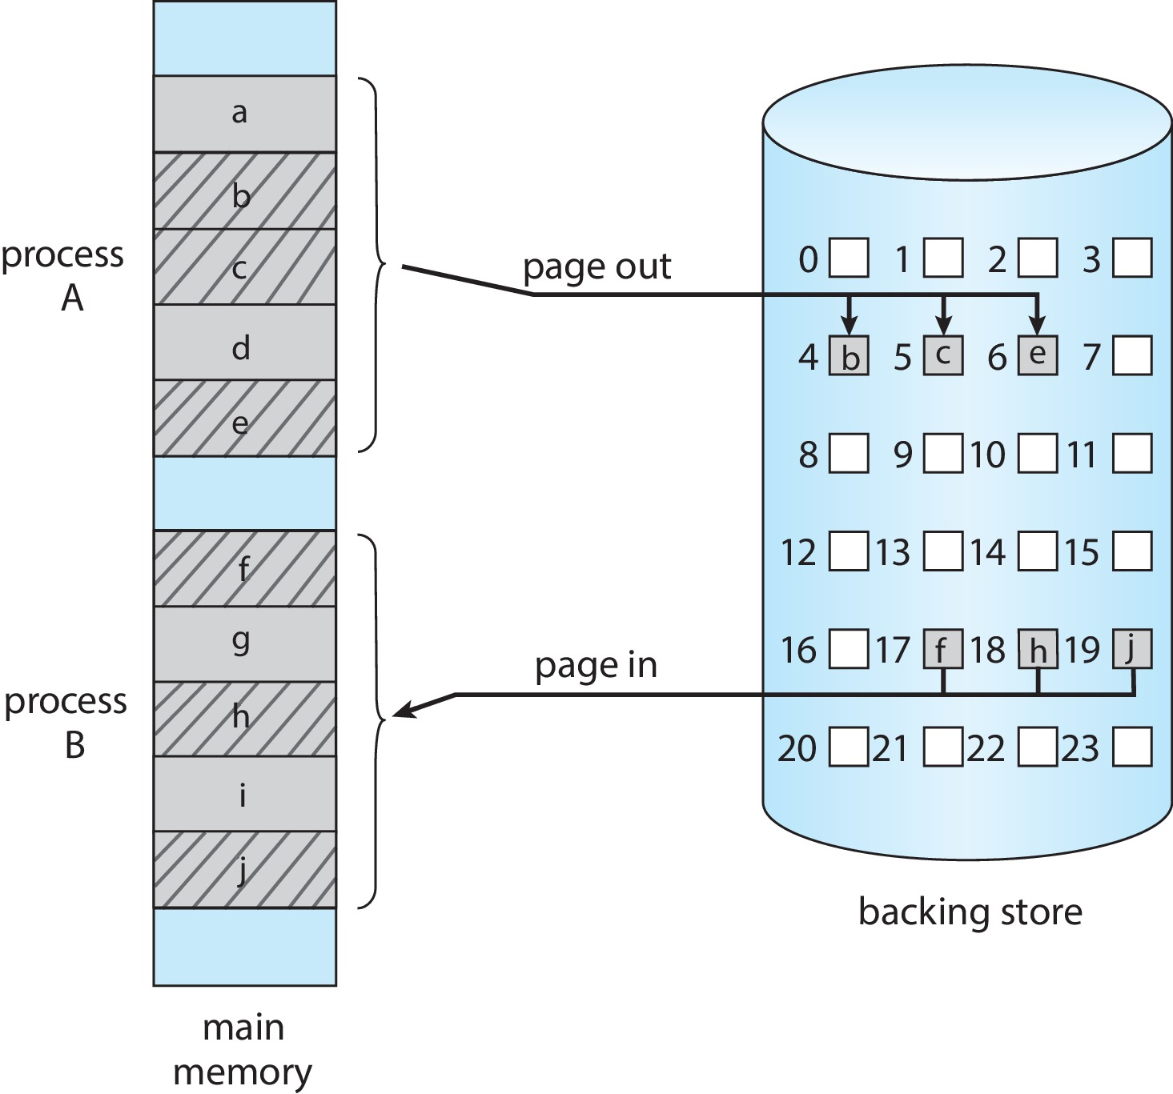
Swapping with Paging

Slide 57
EXTRA SLIDES

Slide 58
Oracle SPARC Solaris
Consider modern, 64-bit operating system example with tightly integrated HW
  Goals are efficiency, low overhead
Based on hashing, but more complex. Two hash tables are used
  One kernel and one for all user processes
  Each maps memory addresses from virtual to physical memory
  Each entry represents a contiguous area of mapped virtual memory,
    More efficient than having a separate hash-table entry for each page
  Each entry has base address and span (indicating no. of pages the entry represents)

Slide 59
Oracle SPARC Solaris
TLB holds translation table entries (TTEs) for fast hardware lookups
  A cache of TTEs reside in a translation storage buffer (TSB)
    Includes an entry per recently accessed page
Virtual address reference causes TLB search
  If miss, hardware walks the in-memory TSB looking for the TTE corresponding to the address
    If match found, the CPU copies the TSB entry into the TLB and translation completes
    If no match found, kernel interrupted to search the hash table
      The kernel then creates a TTE from the appropriate hash table and stores it in the TSB, Interrupt handler returns control to the MMU, which completes the address translation.

Slide 60
Example: The Intel 32 & 64-bit Architectures
Dominant industry chips
Pentium CPUs are 32-bit and called IA-32 architecture
Current Intel CPUs are 64-bit and called IA-64 architecture
Many variations in the chips, cover the main ideas here

Slide 61

Example: The Intel 32 Architecture
Supports both segmentation and segmentation with paging
  Each segment can be 4 GB
  Up to 16 K segments per process
  Divided into two partitions
    First partition of up to 8 K segments are private to process (kept in local descriptor table (LDT))
    Second partition of up to 8K segments shared among all processes (kept in global descriptor table (GDT))
CPU generates logical address
  selector given to segmentation unit which produces linear addresses
  Linear address given to paging unit
    Which generates physical address in main memory
    Paging units form equivalent of MMU
    Pages sizes can be 4 KB or 4 MB

Slide 62
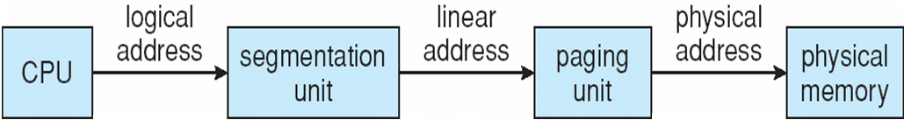
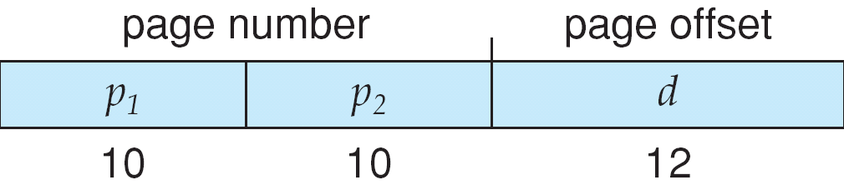
Logical to Physical Address Translation in IA-32

Slide 63
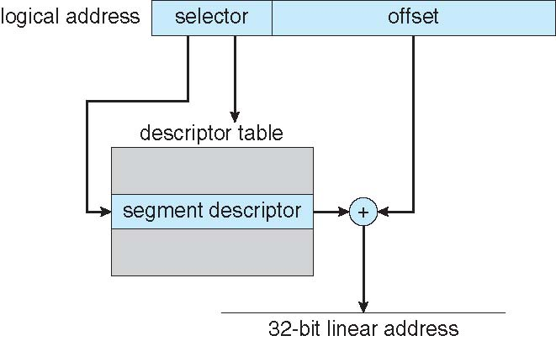
Intel IA-32 Segmentation

Slide 64
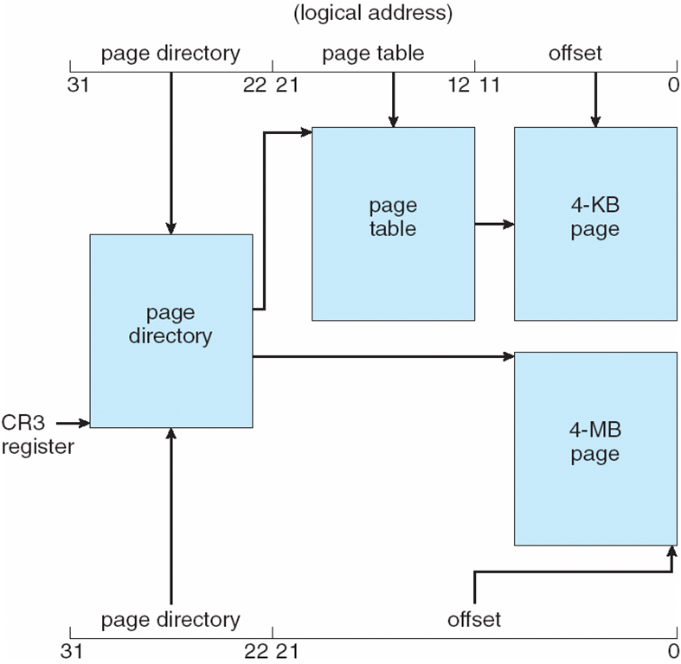
Intel IA-32 Paging Architecture

Slide 65
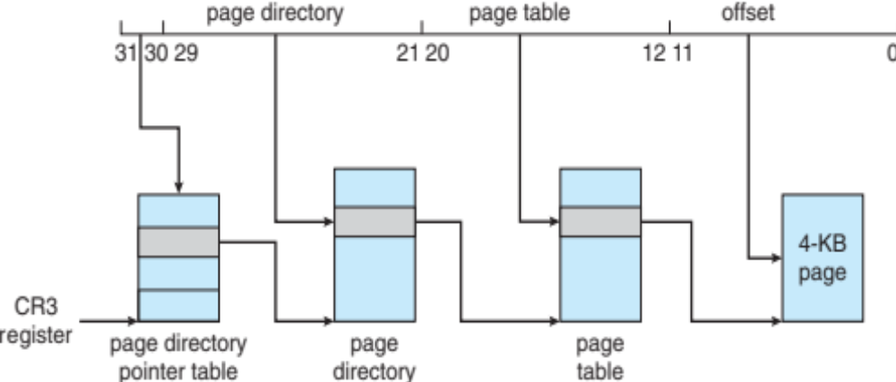
Intel IA-32 Page Address Extensions
32-bit address limits led Intel to create page address extension (PAE), allowing 32-bit apps access to more than 4GB of memory space
  Paging went to a 3-level scheme
  Top two bits refer to a page directory pointer table
  Page-directory and page-table entries moved to 64-bits in size
  Net effect is increasing address space to 36 bits – 64GB of physical memory

Slide 66
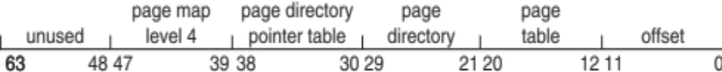
Intel x86-64
Current generation Intel x86 architecture
64 bits is ginormous (> 16 exabytes)
In practice only implement 48 bit addressing
  Page sizes of 4 KB, 2 MB, 1 GB
  Four levels of paging hierarchy
Can also use PAE so virtual addresses are 48 bits and physical addresses are 52 bits

Slide 67
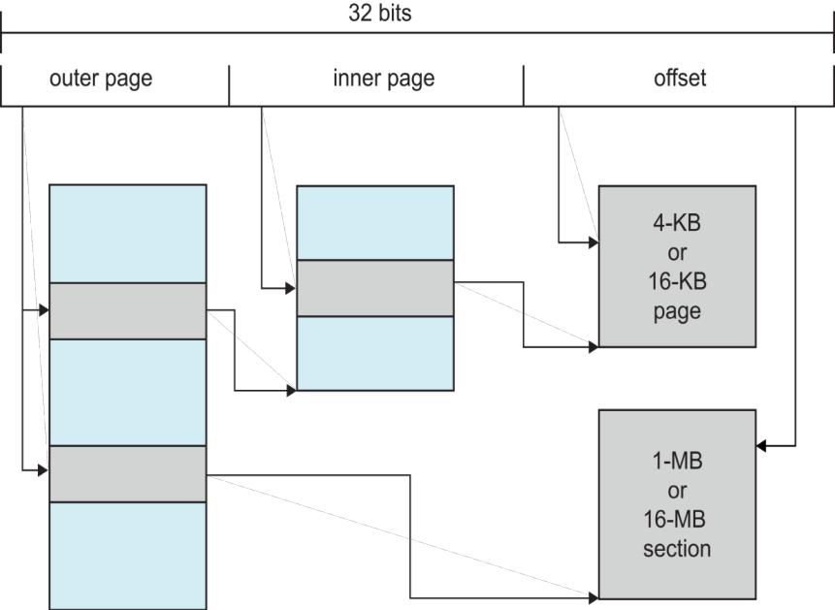
Example: ARM Architecture
Dominant mobile platform chip (Apple iOS and Google Android devices for example)
Modern, energy efficient, 32-bit CPU
4 KB and 16 KB pages
1 MB and 16 MB pages (termed sections)
One-level paging for sections, two-level for smaller pages
Two levels of TLBs
  Outer level has two micro TLBs (one data, one instruction)
  Inner is single main TLB
  First inner is checked, on miss outers are checked, and on miss page table walk performed by CPU

